Slide 1

Module 4 –Kafka architecture

Slide 2

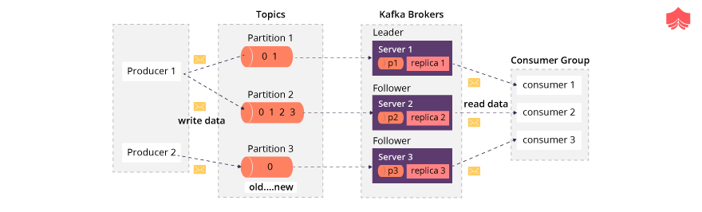
Spark Streaming-Kafka
Let’s recall
Do you know the process diagram of Kafka with components.

Slide 3
Spark Streaming-Kafka
Let’s Recall…
2. What is Zookeeper in Kafka? Can we use kafka without zookeeper?
ZooKeeper is an open-source system which helps in managing the cluster environment of Kafka.
It is an integral part of Kafka architecture.
One can not use Kafka without ZooKeeper.
The client servicing becomes unavailable once ZooKeeper is down.
It facilitates communication between different nodes of the cluster.
In a cluster environment, only one node works as a leader while others are followers system only. It is a ZooKeeper responsibility to choose a leader in a cluster node.
Whenever any server added or removed in a cluster, topic added or removed, ZooKeeper sends that information to each node.
Choosing leadership node, better synchronization between different nodes, configuration management are the key roles of ZooKeeper.

Slide 4
Spark Streaming-Kafka
Let’s recall…
3. Why do we need Kafka rather than other messaging service?
Let’s talk about some modern source of data now a days which is a data—transactional data such as orders, inventory, and shopping carts — is being augmented with things such as clicking, likes, recommendations and searches on a web page. All this data is deeply important to analyze the consumers behaviors, and it can feed a set of predictive analytics engines that can be the differentiator for companies.
Support low latency message delivery.
Handling the real time traffic.
Assurance for fault tolerant.
Easy to integrate with Spark application to process a high volume of messaging data.
Has an ability to create a cluster of messaging container which monitor and supervise by coordination server like Zookeeper.
So, when we need to handle this kind of volume of data, we need Kafka to solve this problem.

Slide 5
Spark Streaming-Kafka
Let’s recall….
4. What is Kafka Cluster? What is the key benefit of creating Kafka cluster?
Kafka cluster is a group of more than one broker.
Kafka cluster has a zero downtime, when we do the expansion of cluster.
This cluster use to manage the persistence and replication of message data.
This cluster offer’s strong durability due to cluster centric design.
In the Kafka cluster, one of the brokers serves as the controller, which is responsible for managing the states of partitions and replicas and for performing administrative tasks like reassigning partitions.

Slide 6
Spark Streaming-Kafka
Let’s recall….
5. What is producer and consumer in Kafka?
Producer is a client who send or publish the record. Producer applications write data to topics and consumer applications read from topics.
Consumer is a subscriber who consume the messages which predominantly stores in a partition. Consumer is a separate process and can be separate application altogether which run in individual machine.

Slide 7
Spark Streaming-Kafka
Let’s recall….
6. What is the working principle of kafka?

Slide 8
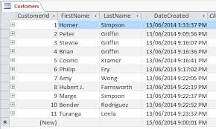
Spark Streaming-Kafka
Topics in Kafka
Particular Stream of data
Similar to table in DB
Identified by Name

Slide 9

BIG DATA
KAFKA
Which Messages get Delivered to Each Subscriber?
Topic based system
Content-based system

Slide 10
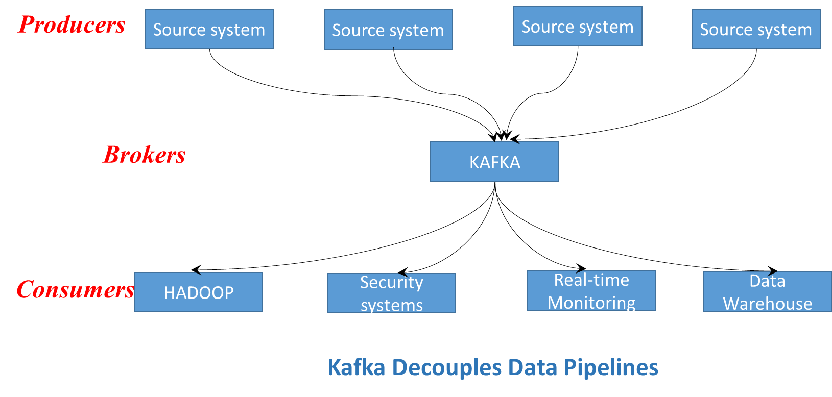
BIG DATA
Topic based routing
Publishers send messages with topic labels
Subscribers subscribe to topics
And will receive all messages on that topic
Example
Subscribe to all fire sensors in b block

Slide 11
BIG DATA
Content based routing
Subscribers define matching criteria
And will receive all messages that match the criteria
Example
Subscribe to all fire sensors in b block

Slide 12
BIG DATA
Communication advantages/disadvantages
Pros
Cons
No hard-wired connections between publishers and subscribers
Flexible: Easy to add and remove publishers or subscribers
Design and maintenance of topics
Performance overhead due to communication infrastructure

Slide 13

BIG DATA
Exercise 2 (5 minutes)
Consider a bookstore portal with various activities such as
Login
List books
Get book details
Buy book
Check status of order
Return book
Logout
Assume we have 3 backend modules
Security
Order processing
Book information
Would you use a topic-based or content-based system? What would be the topics / content..?

Slide 14
BIG DATA
Exercise 2 (Solution)
Would you use a topic-based or content-based system? What would be the topics / content..?
Probably topic-based, since each message type can be a topic

Slide 15
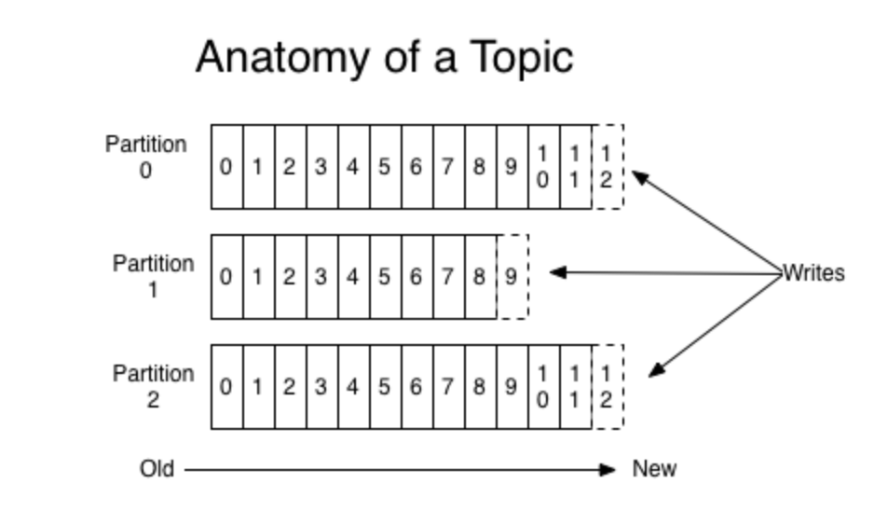
BIG DATA
12 Not the same message
Scaling in Kafka (Partitions)
Scaling in Kafka (Partitions)
Topic with 3 partitions
Publisher decides which partition to write
Partitions allow
Log greater than disk size
Throughput > single server
Distributed over servers
Publisher can load balance
Round-robin
Based on key
Messages have an offset

Slide 16
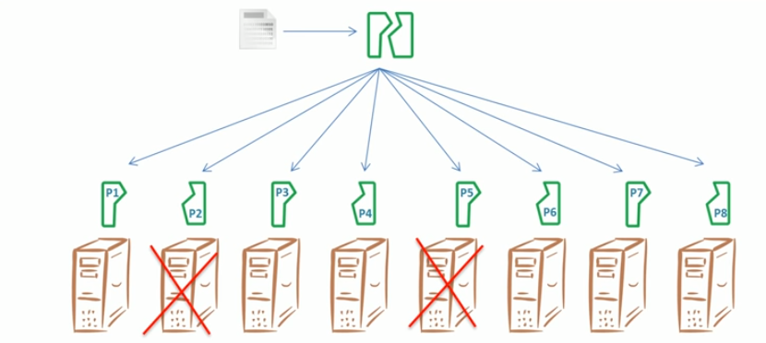
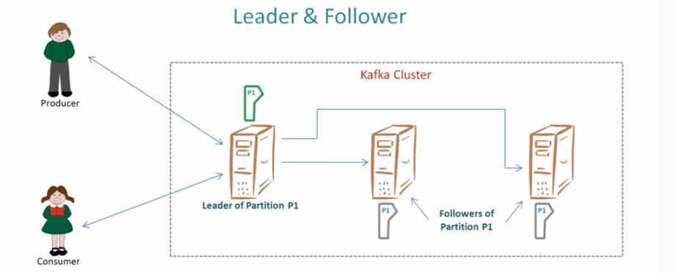
Spark Streaming-Kafka
Fault Tolerance in Kafka
Replication defined for Topic

Slide 17
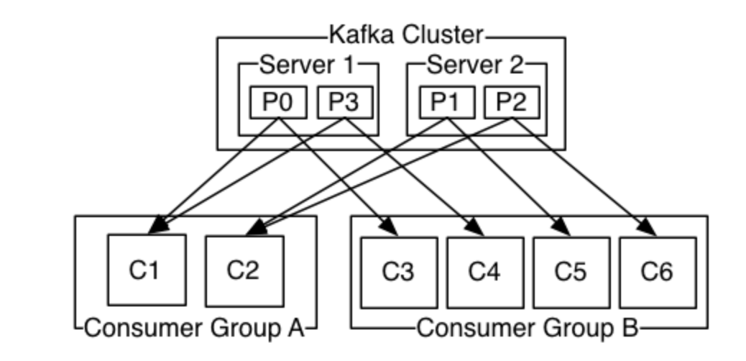
BIG DATA
Exercise 4
Topic with 4 partitions
In the above configuration, how is the load balanced over all the instances?

Slide 18
BIG DATA
Exercise 4 (Solution)
Topic with 4 partitions
Group A
C1 is assigned P0, P3
C2 is assigned P1, P2
Group B
C3 is assigned P0
C4 is assigned P4
…
Each instance has the same number of partitions

Slide 19

BIG DATA
Exercise 5
Suppose we have a Kafka system
1 topic
3 servers
3 partitions
3 replicas per partition
Consumer group with 3 instances
Draw a diagram showing
Servers
Partitions
Consumer instances
Partition assignments

Slide 20
BIG DATA
Exercise 5 (Solution)
Suppose we have a Kafka system
1 topic
3 servers
3 partitions
3 replicas per partition
Consumer group with 3 instances
Draw a diagram showing
Servers
Partitions
Consumer instances
Partition assignments
Server 0
Server 1
Server 2
Replicas
P1
P2
P0
P2
P0
P1
Leader
P0
P1
P2
Consumer Group
C0
C1
C2

Slide 21
THANK YOU

